Slide 1
Data Visualization for Data Scientist Roles
Submitted by:
Reshma Paturi

Slide 2
Analysis Questions
What are the skills that are most needed for Data Scientist roles?
What is the average salary for Data Scientist roles in different states of USA?
What are the cities of USA with more number of Data Scientist jobs ?
What are the states of USA with more number of Data Scientist jobs ?
How many Data Scientist job roles are available at different experiences in different states?
Difference in number of Data scientist jobs and other jobs in different states of USA.

Slide 3
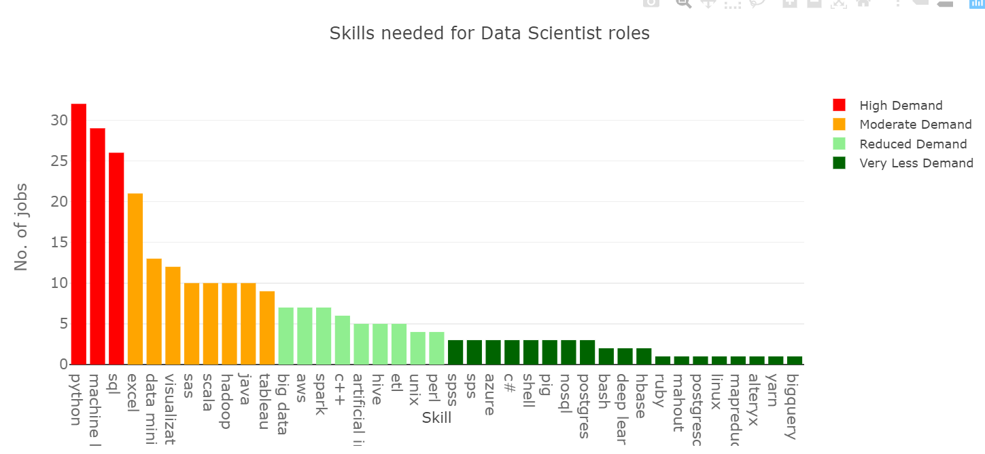
Demand of different skills in data science job market.
Used plotly package to generate this graph.
This graph can be used to analyze the skills that are of High demand, Moderate
demand, reduced demand and
very low demand in data
science job market.
The top 3 skills with high demand for data scientist roles are Python, Machine Learning and SQL.

Slide 4
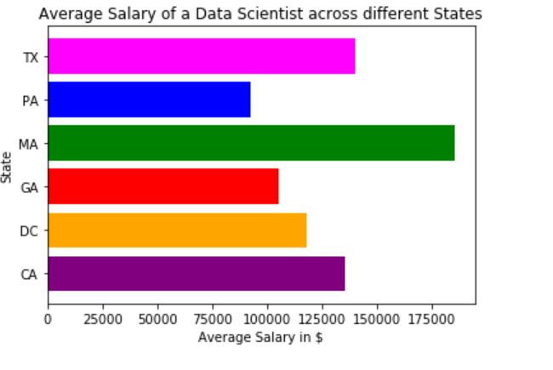
Analysis of average salary for Data Scientist roles across different states
Used matplotlib to generate this map.
Used to analyze the average salary of Data scientist roles across different states.
Out of the 6 states in this analysis, MA(Massachusetts) has the highest average salary of 176000$ per annum for data scientist roles.

Slide 5
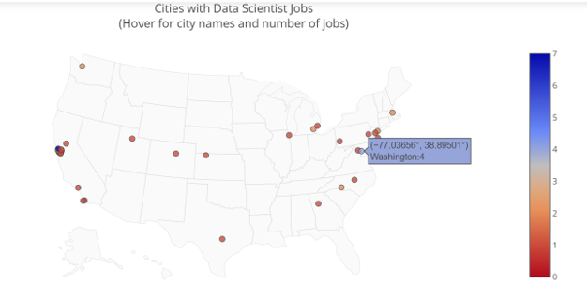
Data Scientist Jobs Across Cities
Used plotly and geopy packages to generate this map.
Used to identify the concentration of DS jobs in different cities of USA.
From this map plot, we can observe that Washington have 4 jobs highlighted as light blue.
The city with highest job postings here is San Francisco highlighted as dark blue.

Slide 6
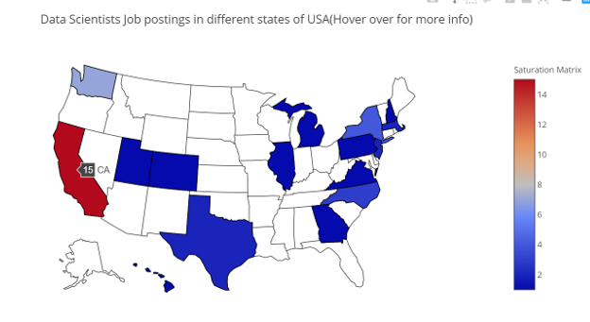
Concentration of Data Scientist roles in different states
Used plotly package to generate this map.
Used to identify the concentration of DS jobs in different states of USA.
From this map plot, we can observe that California has highest number of job postings of 15, highlighted as red.

Slide 7
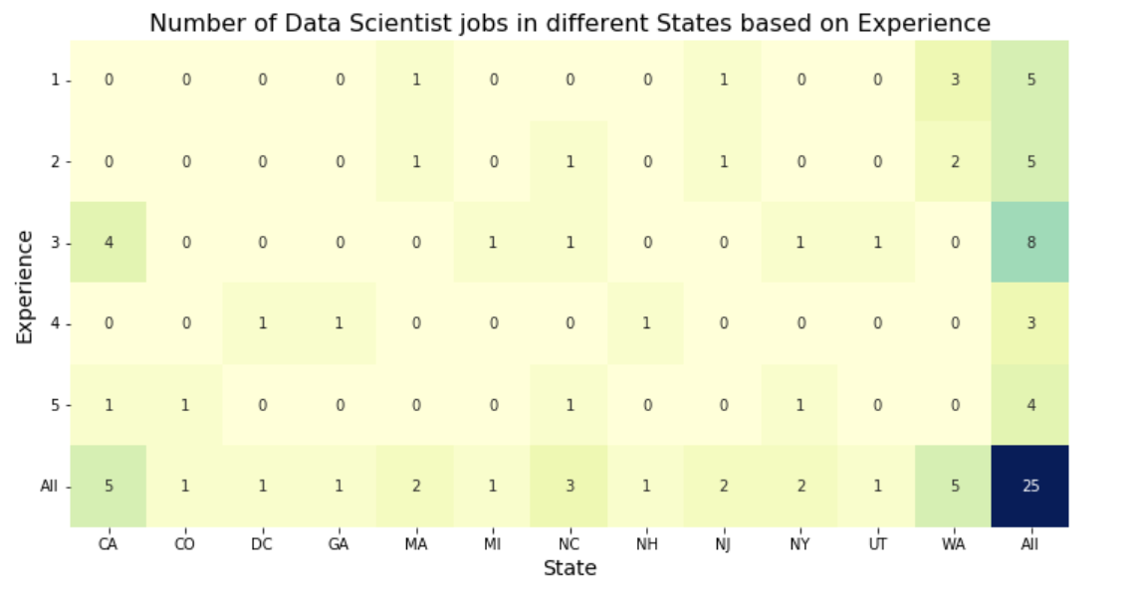
Data Scientist Experience Heatmap
Used matplotlib and seaborn packages to generate this map.
Used to analyze number of DS jobs at different experience levels are available across different states.
There appear more Data scientist roles with minimum experience of 3 years when compared to others from the map.

Slide 8
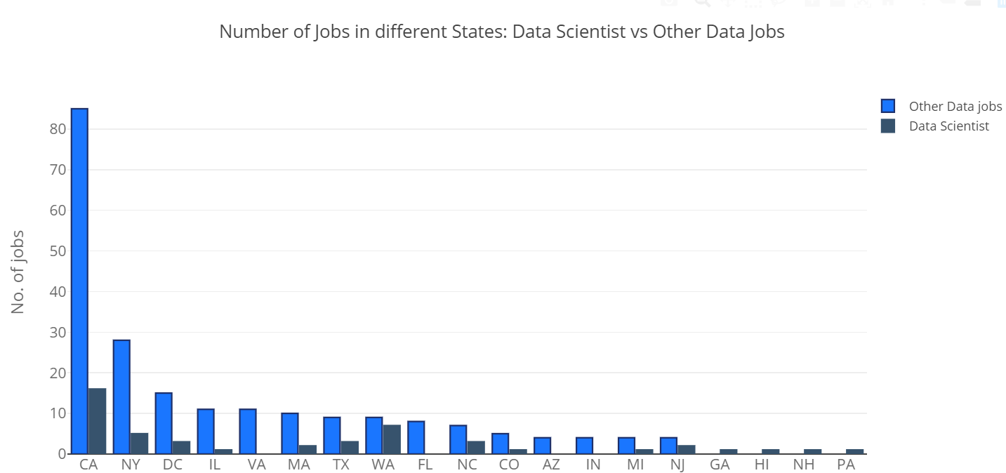
Data scientist Vs Other Job Titles
Used ploly package to generate this graph.
Used for the comparison of number of data scientist roles and other jobs across different states.
We can observe in most of the states, data scientist roles are less compared to other jobs like business analyst, data analyst etc.
States like GA, HI, NH, PA seem to have more data scientist jobs compared to other jobs.

